Slide 1
JIRA
Jira is a popular project management and issue tracking tool developed by Atlassian
Jira is a software application that helps teams plan, track, and manage projects and tasks
It supports Agile methodologies like Scrum and Kanban

Slide 2
Key Features of Jira
Issue Tracking: Create, prioritize, and assign tasks or issues.
Customization: Tailor workflows, issue types, and fields to your needs.
Integration: Seamlessly integrates with other tools and plugins.
Reporting: Robust reporting and dashboard capabilities.
Collaboration: Commenting, and notifications.
Visual: Icons representing the features

Slide 3
Terminologies in Jira
Epic
Stories
Tasks

Slide 4
Aspects of Jira
Projects
Issues
Issue Types
Advanced Workflows
Boards
Dashboards and Reports
Agile Methodologies
Time Tracking

Slide 5
Advantages and Disadvantages of Jira
Advantages
Disadvantages
Effective Issue Tracking
Customization
Agile Support
User Collaboration
Flexibility
Complexity
Cost
Customization Challenges
Learning Curve

Slide 6
Resources
https://aws.amazon.com/what-is/sdlc/#:~:text=The%20software%20development%20lifecycle%20(SDLC,expectations%20during%20production%20and%20beyond
https://www.youtube.com/watch?v=i-g4XK0voUw&list=PLPzfPcir5uPR8vKjOFitZZdEIT8-snomq
https://www.youtube.com/watch?v=u8eB-hKwHVo&t=256s

Slide 7
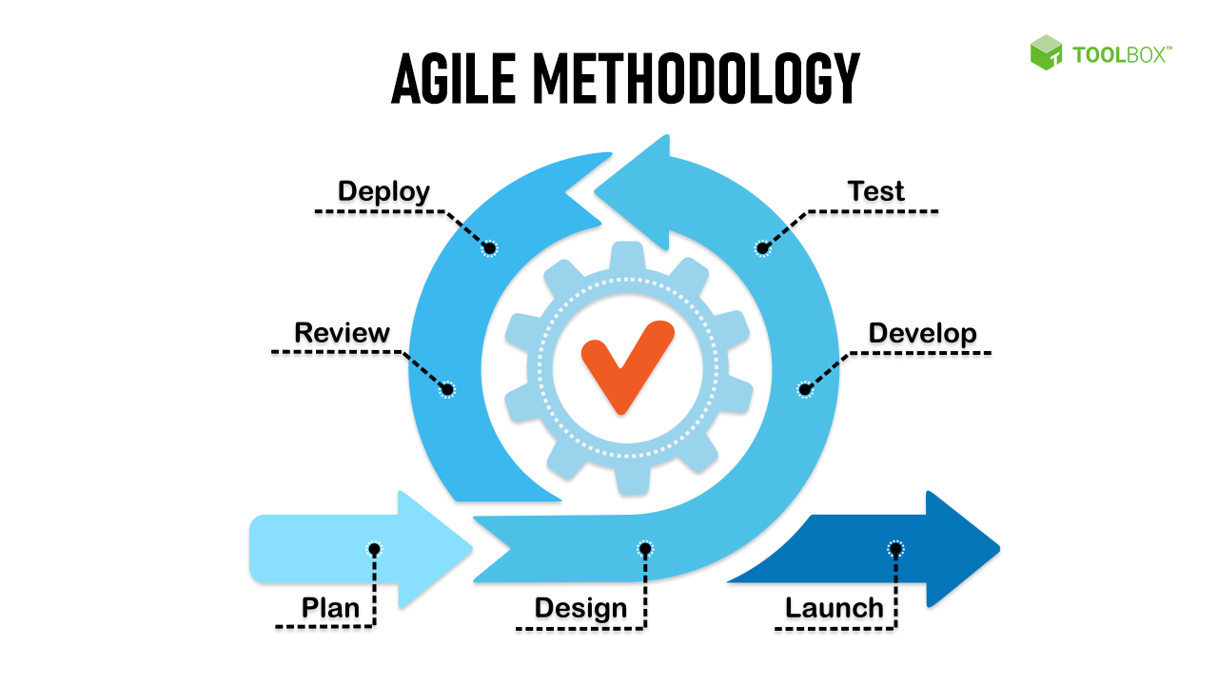
Agile Methodologies
Agile methodologies are a set of flexible and iterative approaches to software development and project management

Slide 8
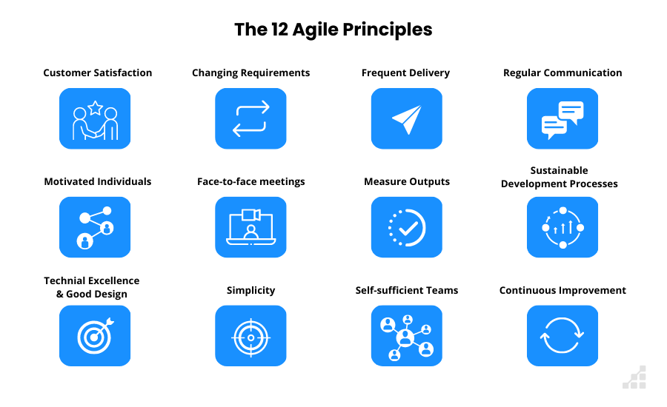
Agile Principles

Slide 9
Agile methodology frameworks
Agile Manifesto
Scrum
Crystal
Kanban
Extreme Programming (XP)
Lean Software Development
Feature-Driven Development (FDD)
Dynamic Systems Development Method (DSDM)

Slide 10
Sprint Planning
Sprint Planning is a Scrum framework
Scrum Team collaboratively plans the work to be done during the upcoming Sprint
Preparation
Sprint Planning Meeting
What Can Be Done (Capacity)
What Will Be Done (Selection)
Defining the Sprint Goal
Task Breakdown
Commitment
Sprint Backlog

Slide 11
Benefits of Agile
Flexibility and Adaptability
Faster Time-to-Market
Improved Quality
Transparency
Higher Productivity
Enhanced Risk Management
Continuous Improvement
Customer Satisfaction:

Slide 12
Resources
https://www.wrike.com/project-management-guide/agile-methodology-basics/
https://www.youtube.com/watch?v=WjwEh15M5Rw&t=491s
https://www.youtube.com/watch?v=g39DSL576Zs
https://www.youtube.com/watch?v=6fKn4rgk4jM

Slide 13
THANK YOU

